Slide 1
control algorithm for a three-phase inverter
Yanal Gawanma 211713227 Mohmmad Sarris 206983199
Spring 2024

Slide 2
Project goals
Develop a Three-Phase Inverter Control Algorithm.
Grid Synchronization Under Fault Conditions.
Design an LCL Filter for EMI Compliance.
Dynamic Reactive Power Injection.
Testing Across Different Grid Parameters.
Performance Analysis.

Slide 3
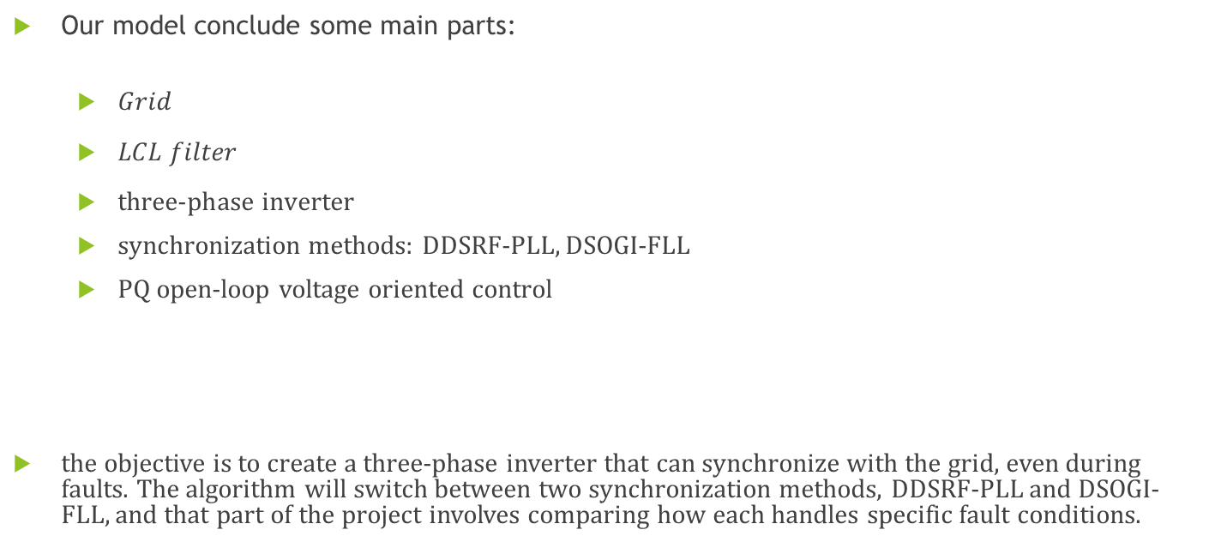
System Description
Our model conclude some main parts:
$Grid$
$LCL filter$
$\text{three}\text{−}\text{phase} inverter$
synchronization methods: DDSRF-PLL, DSOGI-FLL
PQ open-loop voltage oriented control
the objective is to create a three-phase inverter that can synchronize with the grid, even during faults. The algorithm will switch between two synchronization methods, DDSRF-PLL and DSOGI-FLL, and that part of the project involves comparing how each handles specific fault conditions.

Slide 4
The Grid
The grid is modeled as voltage sources.
Grid Voltage Characteristics
The project connects to a standard three-phase 400V grid.
The inverter synchronizes with grid parameters, requiring precise alignment with voltage and frequency
Challenges of Grid Integration
Grid faults can occur, such as single-phase to ground, two-phase short circuits, and two-phase to ground faults.
Maintaining stability during these disturbances is crucial for reliable operation.
Dynamic Conditions and Stability
Grid conditions, including voltage fluctuations and frequency changes, require adaptive control.
Grid-Inductance Testing
Testing with grid inductances ranging from 50 µH to 3 mH to evaluate performance under different conditions.
An X/R ratio (reactance-to-resistance) of 2 to 10 is used to simulate various grid characteristics.

Slide 5
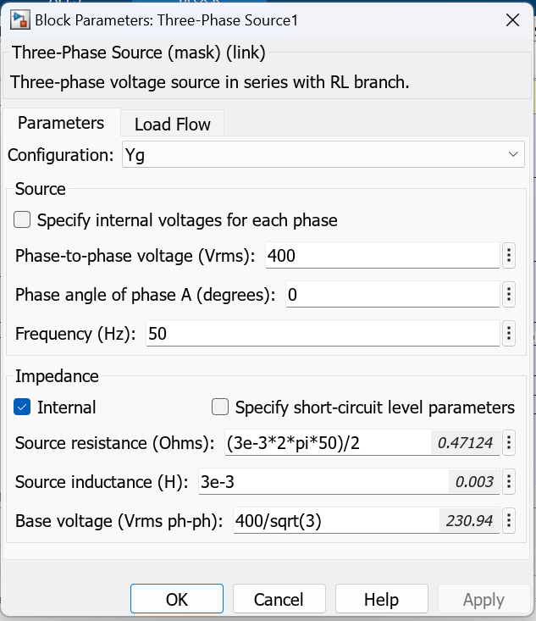
The Grid parameters

Slide 6
LCL Filter
Purpose of the LCL Filter:
Reduces high-frequency harmonics produced by the inverter, ensuring smoother power flow to the grid.
Essential to meet EMI (Electromagnetic Interference) standards and improve power quality.
Components of the LCL Filter:
Grid-side Inductance (Lg): Acts as a buffer between the filter and the grid, attenuates remaining harmonics.
Inverter-side Inductance (Li): Limits high-frequency components from the inverter.
Capacitance (Cf): Provides an impedance path for high-frequency harmonics, further filtering the output.
Filter Design Parameters:
Selected values for Lg, Li, and Cf based on target harmonic attenuation.

Slide 7
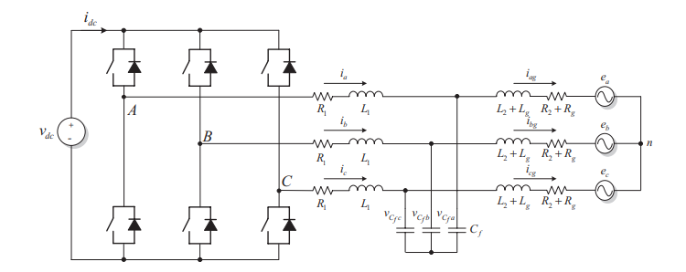
LCL Filter
LCL-filter inverter connected to the grid:

Slide 8



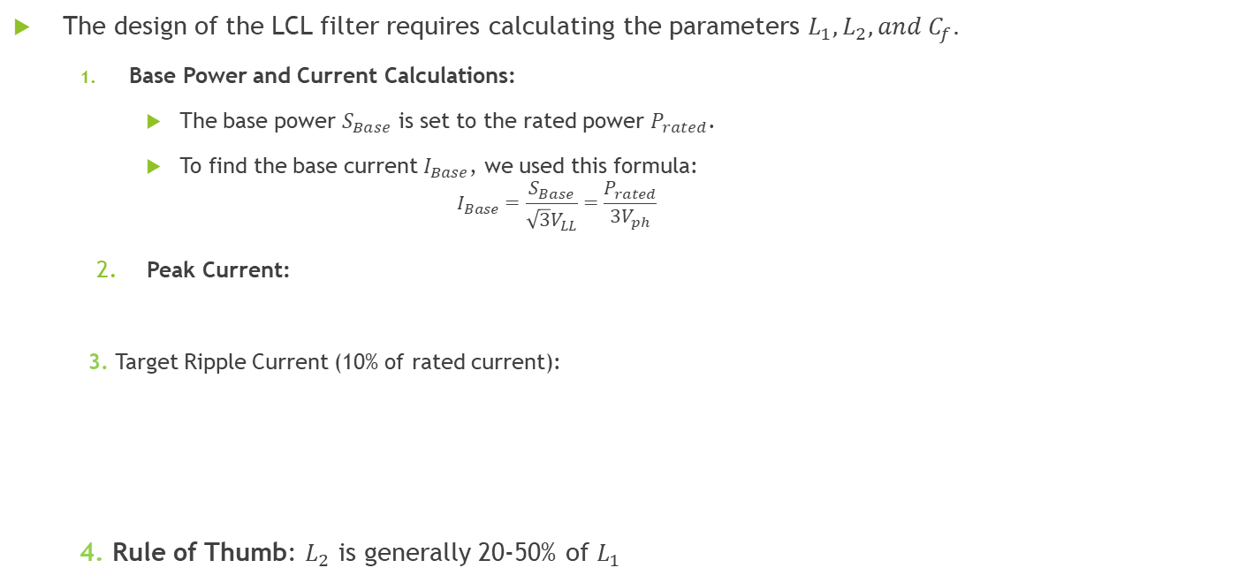
Filter Design Parameters
The design of the LCL filter requires calculating the parameters $L_{1},L_{2},and C_{f}.$
Base Power and Current Calculations:
The base power $S_{Base}$​ is set to the rated power $P_{rated}$​.
To find the base current $I_{Base}$, we used this formula:
$$I_{Base}=\frac{S_{Base}}{{\sqrt{3}V}_{LL}}=\frac{P_{rated}}{3V_{ph}}$$
Peak Current:
3. Target Ripple Current (10% of rated current):
4. Rule of Thumb: $L_{2}$​ is generally 20-50% of $L_{1}$

Slide 9


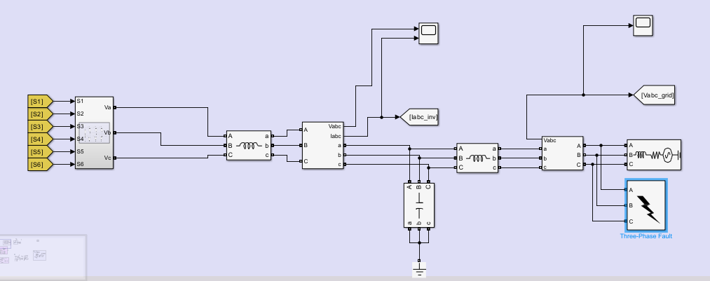





Filter Design Parameters
5. Target Resonant Frequency $f_{res}$​:
6. Resonant Frequency Calculation:
$$L_{1}$$
$$L_{2}$$
$$C_{f}$$

Slide 10
Three-Phase Inverter Design
Objective of the Inverter:
Convert DC from the 800V DC link to a three-phase 400V AC output for grid connection.
Enable bidirectional power flow with efficient and stable operation under varying conditions.
Specifications:
Power Level: 160 kW
Switching Frequency: 120 kHz
Compliance: Group 1 Class B EMI requirements
Fault Management:
Responds to grid faults (single-phase to ground, two-phase short, two-phase short to ground).
Reduces active power and injects reactive power during low voltage conditions.

Slide 11
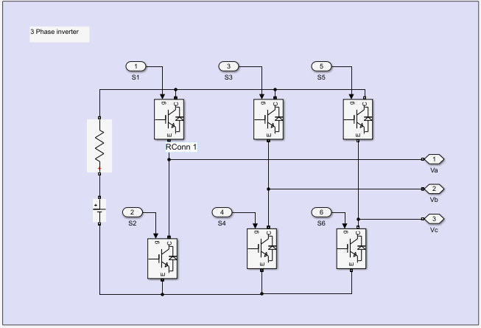
Inverter Design

Slide 12
DDSRF-PLL
What is DDSRF-PLL?
Stands for Double Second-Order Generalized Integrator Phase-Locked Loop.
A method for aligning the inverter output with the grid's phase and frequency.
Key Features of DDSRF-PLL:
Provides fast and accurate phase detection.
Effective at tracking the grid's frequency and phase even under unbalanced or distorted conditions.
Uses a double synchronous rotating reference frame for stability in various grid scenarios.
Importance in This Project:
Ensures the inverter’s output matches the grid for seamless power transfer.
Supports dynamic synchronization during normal operation and faults, which helps maintain grid stability.
Critical for handling grid faults like single-phase to ground or two-phase shorts by maintaining stable frequency and phase tracking.

Slide 13
DSOGI-FLL
What is DSOGI-FLL?
Stands for Double Second-Order Generalized Integrator with Frequency-Locked Loop.
A method for synchronizing the inverter with the grid by tracking frequency and phase.
Key Features of DSOGI-FLL:
Uses a Frequency-Locked Loop to detect grid frequency.
Incorporates a second-order generalized integrator (SOGI) to filter and extract grid voltage components.
Suitable for unbalanced and distorted grid conditions, as it separates positive and negative sequence components.
Importance in This Project:
Ensures frequency stability in the inverter output, even under grid disturbances.
Provides accurate synchronization, which is crucial for grid connection.
Helps maintain operation during grid faults by adjusting to changes in frequency.

Slide 14
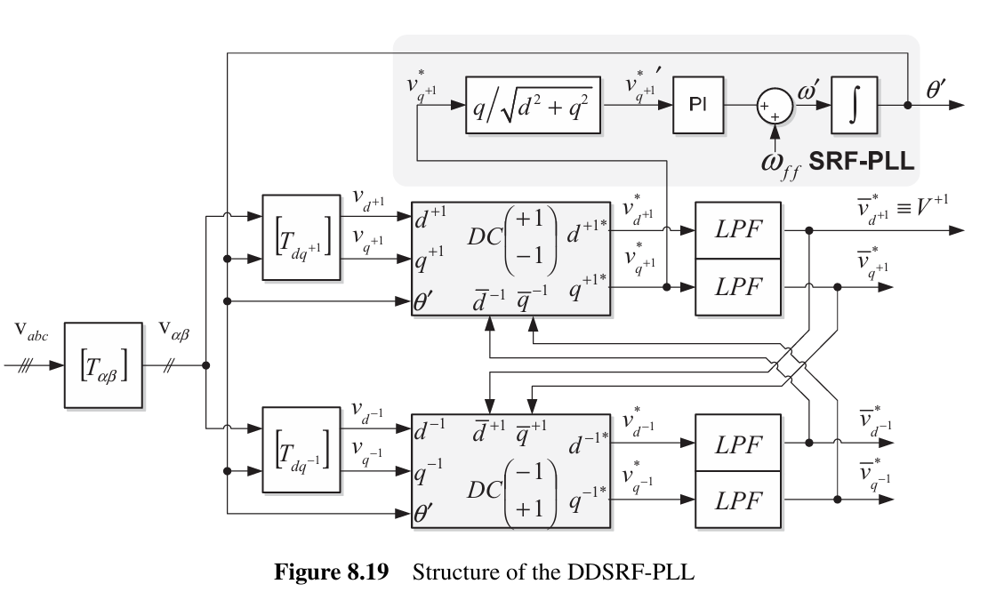
DDSRF-PLL

Slide 15
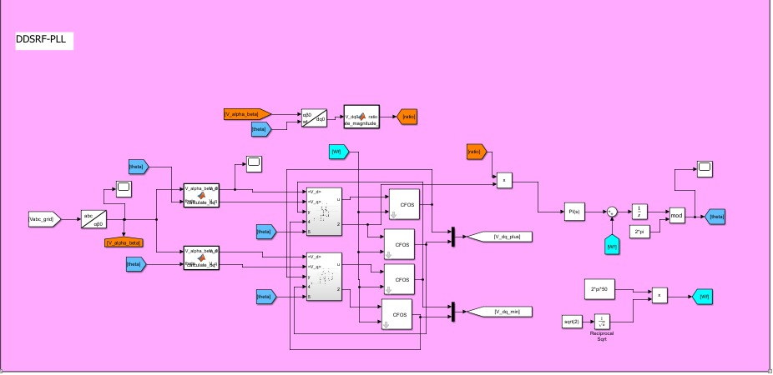
DDSRF-PLL

Slide 16
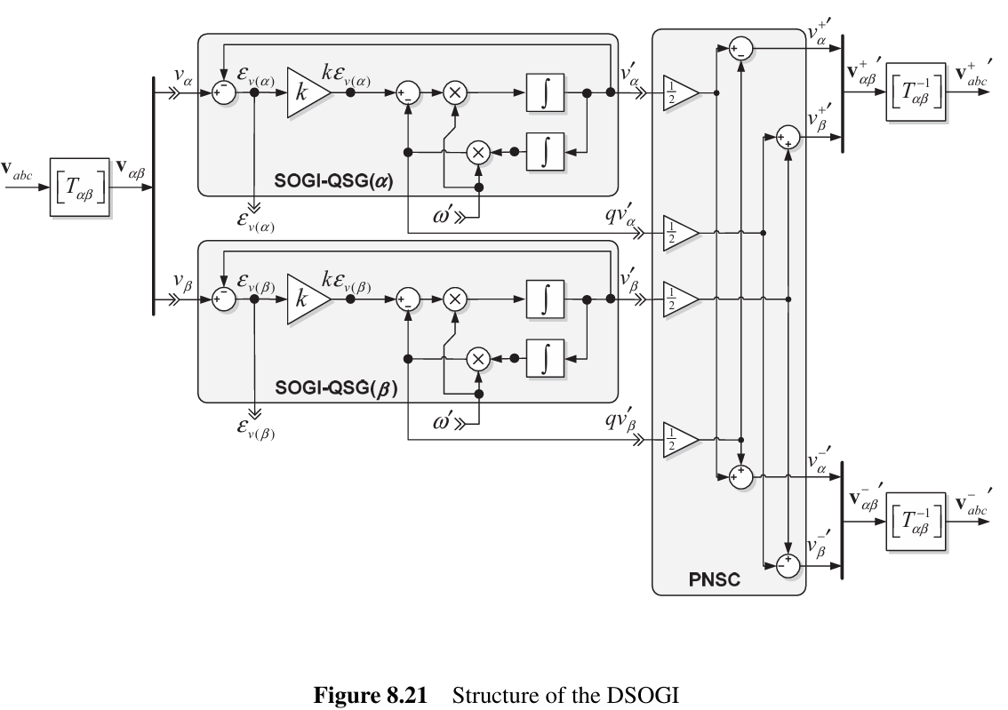
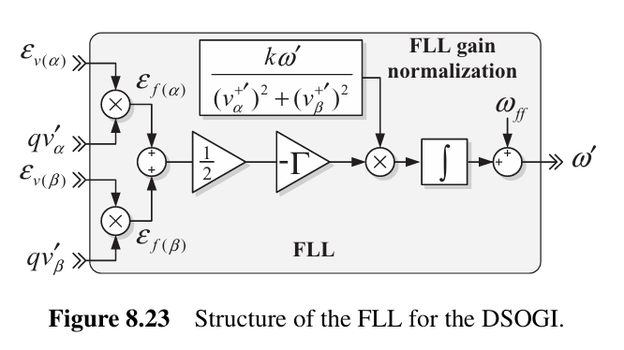
DSOGI-FLL

Slide 17
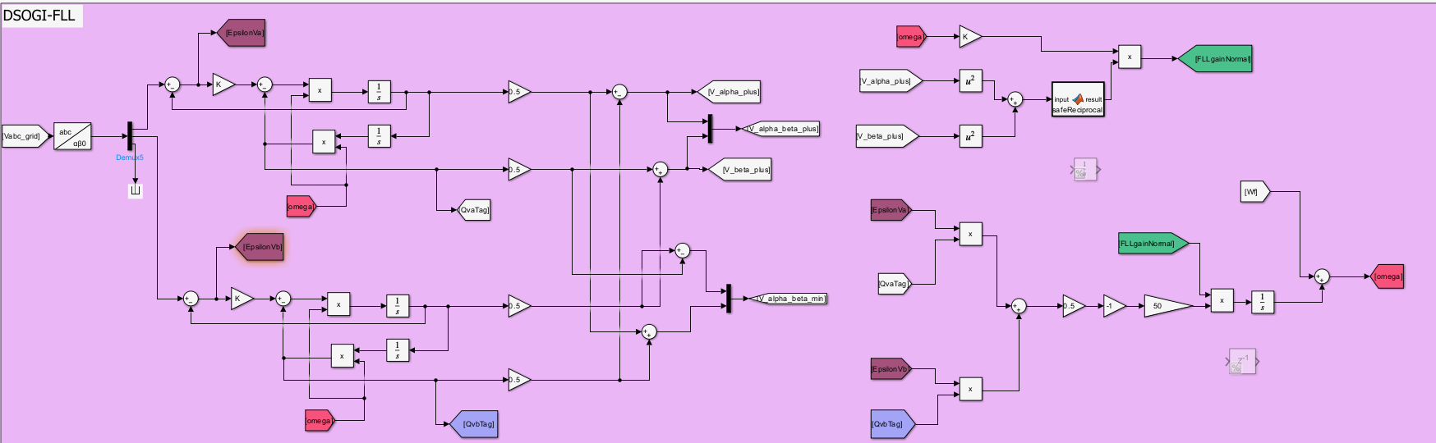
DSOGI-FLL

Slide 18
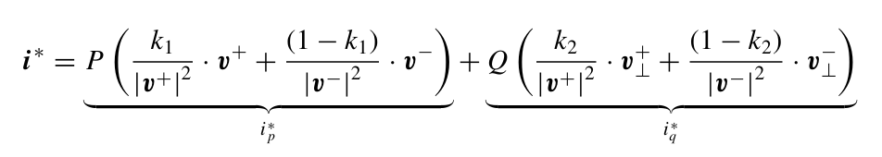
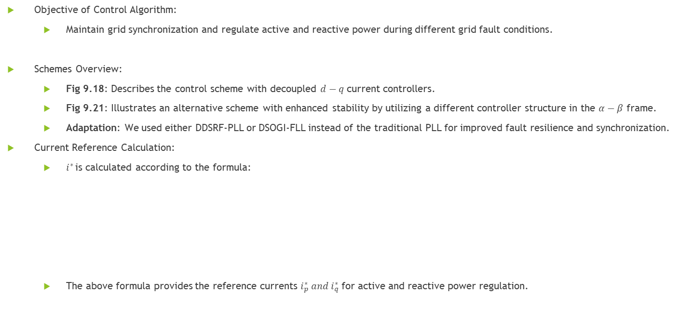
Control Algorithm for Grid-Connected Inverter
Objective of Control Algorithm:
Maintain grid synchronization and regulate active and reactive power during different grid fault conditions.
Schemes Overview:
Fig 9.18: Describes the control scheme with decoupled $d−q$ current controllers.
Fig 9.21: Illustrates an alternative scheme with enhanced stability by utilizing a different controller structure in the $α−β$ frame.
Adaptation: We used either DDSRF-PLL or DSOGI-FLL instead of the traditional PLL for improved fault resilience and synchronization.
Current Reference Calculation:
$i^{∗ }$is calculated according to the formula:
The above formula provides the reference currents $i_{p}^{∗} and{ i}_{q}^{∗}$for active and reactive power regulation.

Slide 19
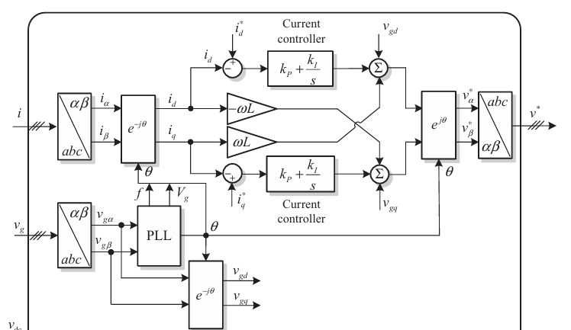
Figure 9.18 PQ open-loop voltage oriented control

Slide 20
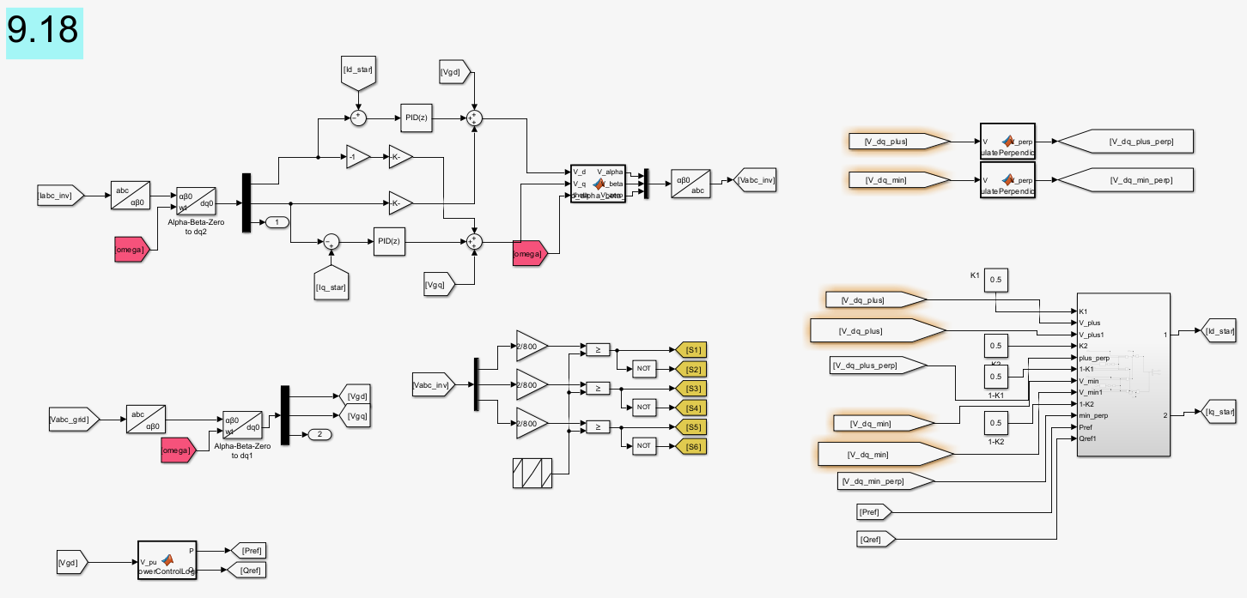
Figure 9.18 PQ open-loop voltage oriented control

Slide 21
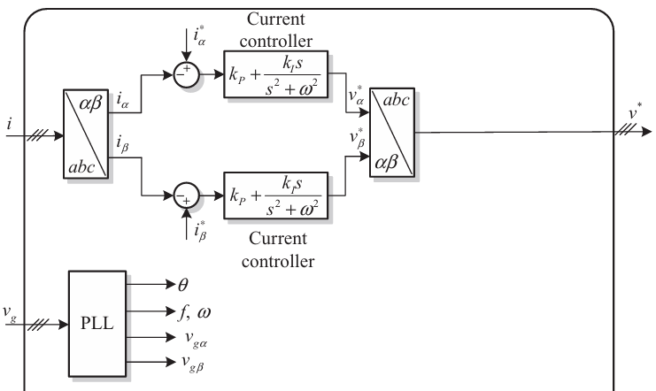
Figure 9.21 PQ open-loop voltage oriented control

Slide 22
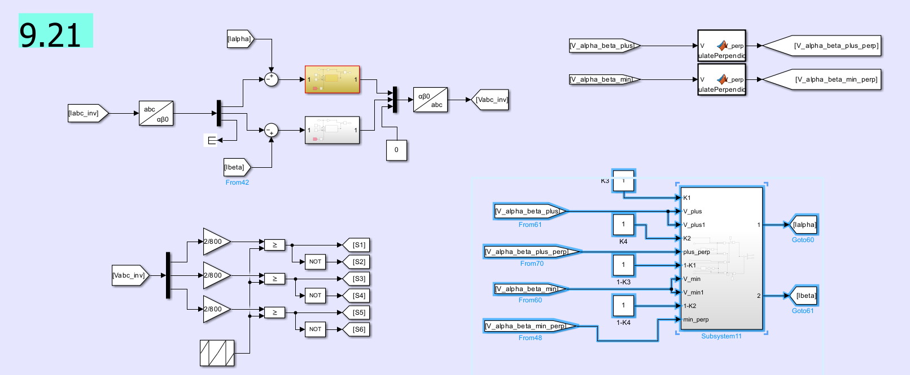
Figure 9.21 PQ open-loop voltage oriented control

Slide 23
Comparison of Results
Key Parameters for Comparison:
Frequency stability
Amplitude consistency
Phase alignment with the grid
Response to disturbances
Metrics Used:
Frequency and Phase Response: How accurately and quickly does the inverter align with the grid’s frequency and phase during steady-state and fault conditions?
Voltage and Current Amplitude Consistency: Measure the RMS and peak values to ensure they stay within expected ranges, even under faults.
Transient Behavior During Faults: Evaluate response speed, overshoot, and damping after disturbances such as single-phase or two-phase faults.
Harmonic Distortion: Analyze total harmonic distortion in voltage and current to assess waveform quality.
Performance Comparison of DDSRF-PLL and DSOGI-FLL:
DDSRF-PLL: Stability in phase alignment and frequency tracking, especially under balanced conditions.
DSOGI-FLL: Enhanced response time and harmonic filtering, more robust in unbalanced or distorted grid conditions

Slide 24
Comparison of Inductance Impact on Fault Response (3 mH vs. 50 µH)
After comparing the results:
3 mH Inductance:
Results in lower peak currents, reducing stress on system components.
Damps oscillations more effectively, resulting in a smoother response.
Longer settling time, but improved fault tolerance and system stability.
50 µH Inductance:
Produces higher peak currents during fault conditions.
Faster initial response but with pronounced oscillations.
Lower settling time but may stress components more due to higher peak currents.

Slide 25
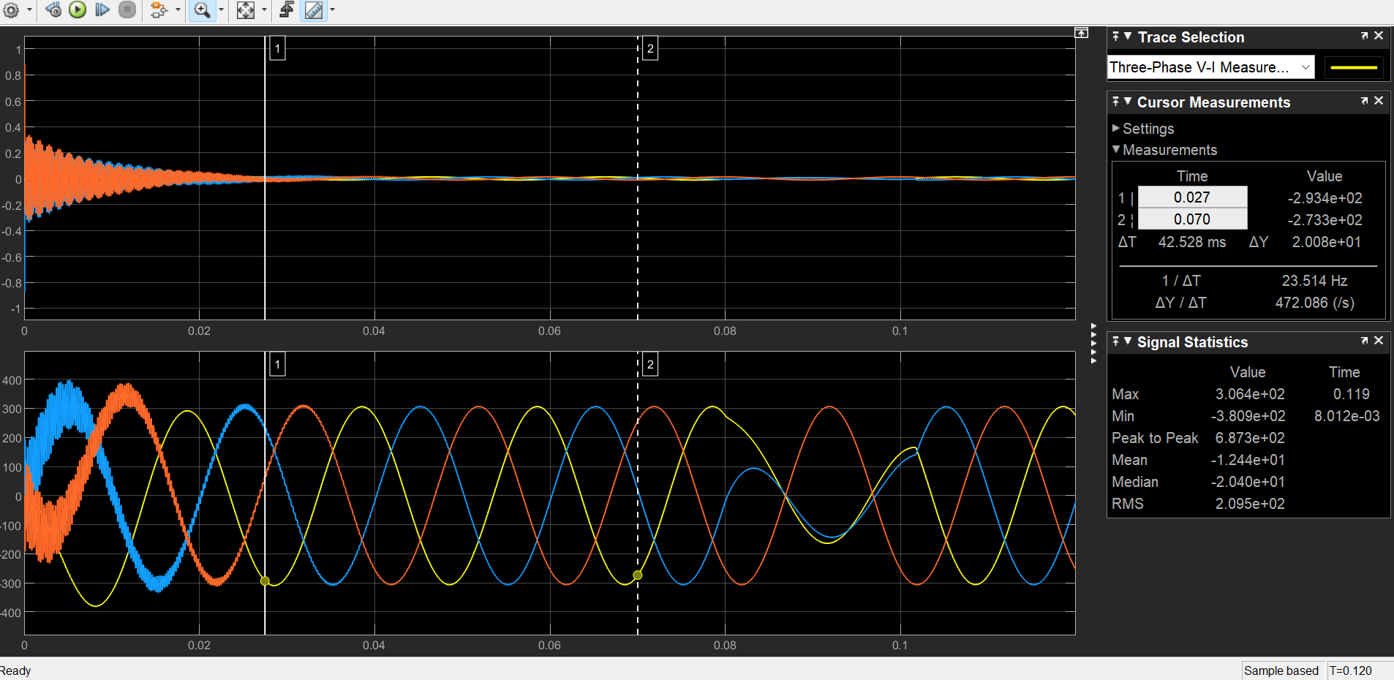
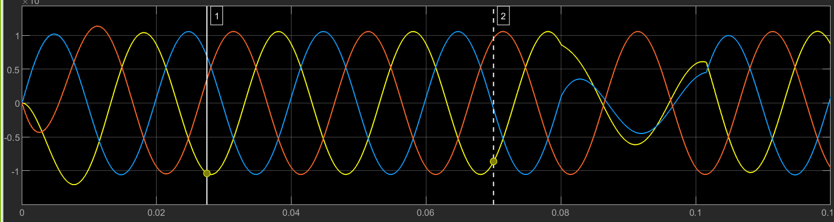
Comparison of Inductance Impact on Fault Response (3 mH vs. 50 µH)
Examples:
Fault analysis using FLL synchronization with X/R = 2 in 9.18.
Two-phase short fault scenario under different inductances.
3 mH
50uH

Slide 26
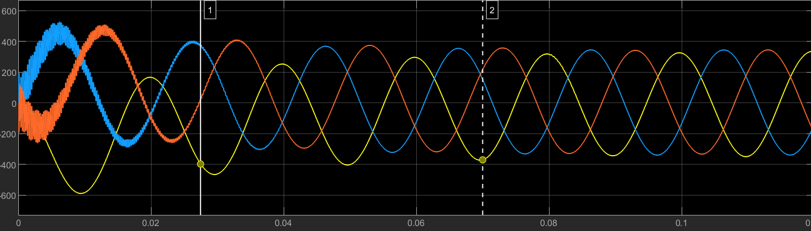
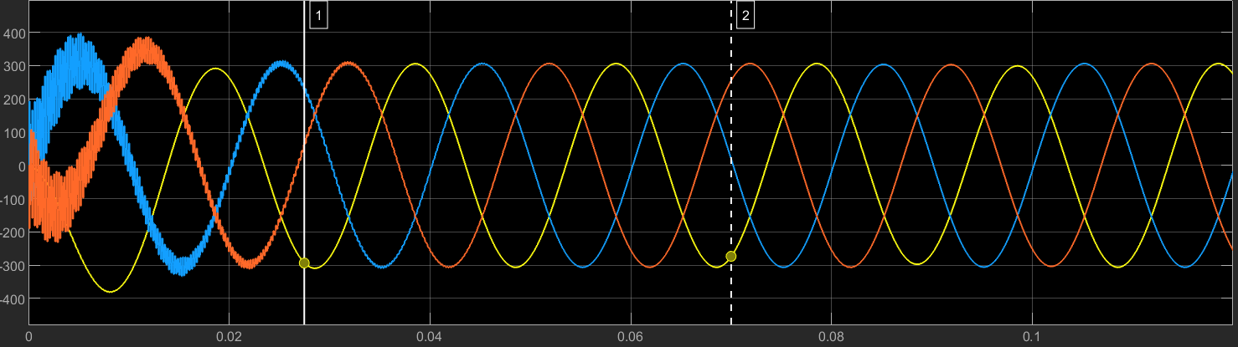
Comparison of X/R Ratio Impact on Fault Response (2 vs. 10)
The impact of different X/R ratios on system damping and stability:
a higher X/R ratio (X/R = 10) leads to larger and more sustained oscillations, which can challenge system stability.
a lower X/R ratio (X/R = 2) provides better damping, leading to quicker stabilization after a fault event.
X/R = 10
X/R = 2

Slide 27
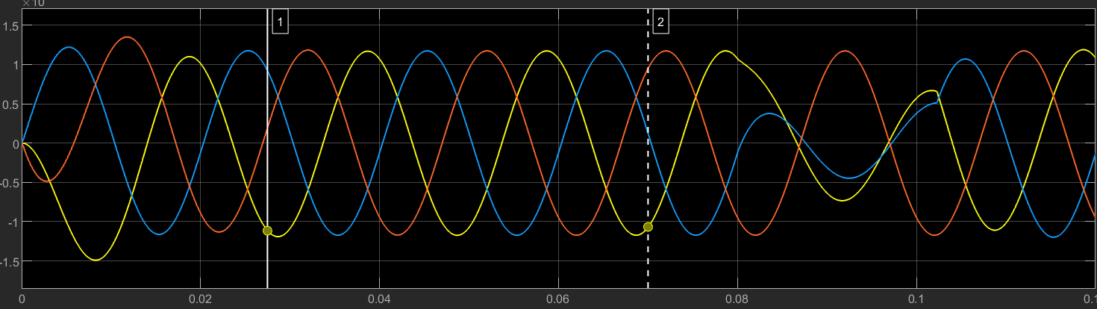
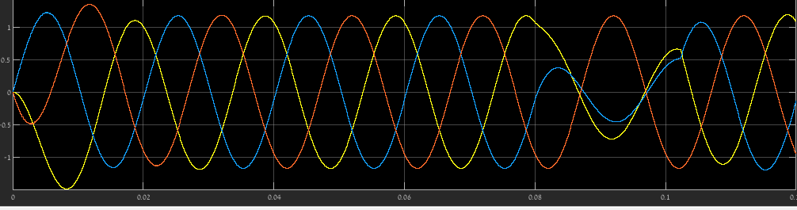
Comparison of synchronization methods Impact on Fault Response (PLL vs. FLL)
Conclusion: PLL demonstrates a more controlled and stable response, with better phase alignment, smoother oscillations, and faster stabilization. In contrast, the FLL response is more prone to transient fluctuations and slight frequency variations, which could affect stability under fault conditions.
FLL
PLL

Slide 28
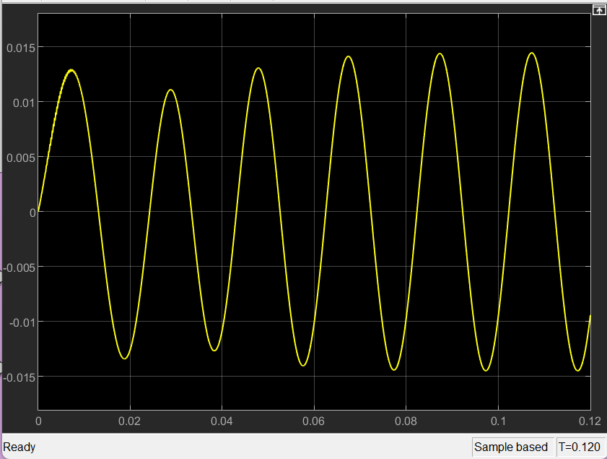
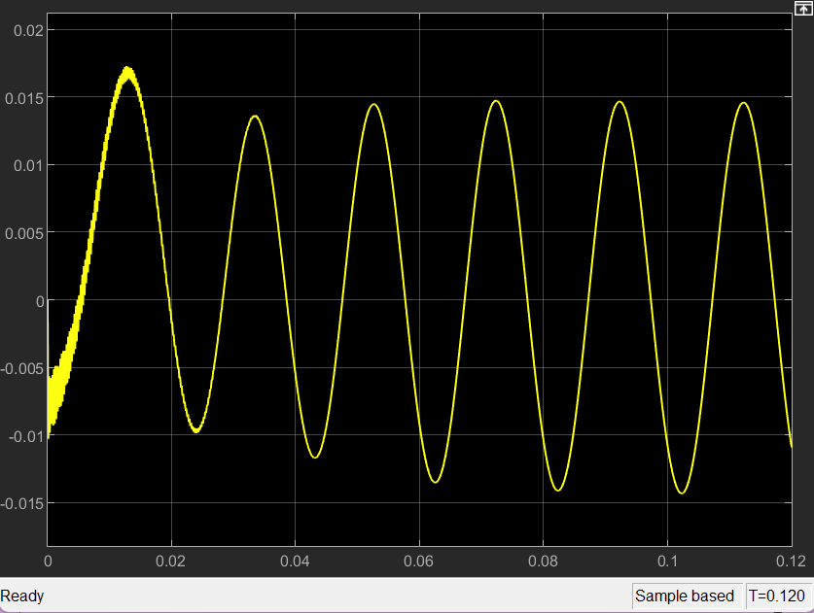
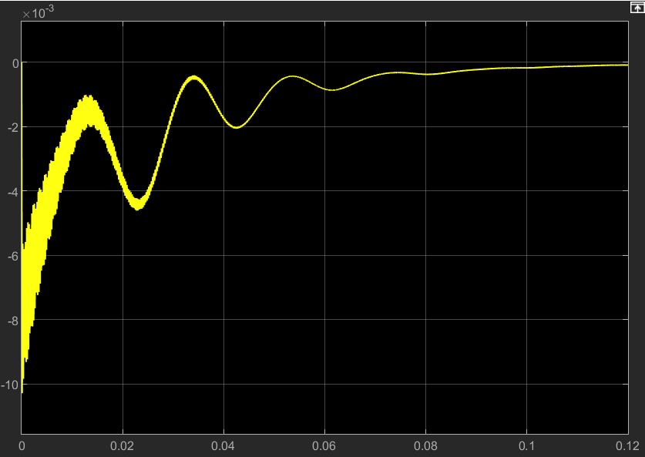
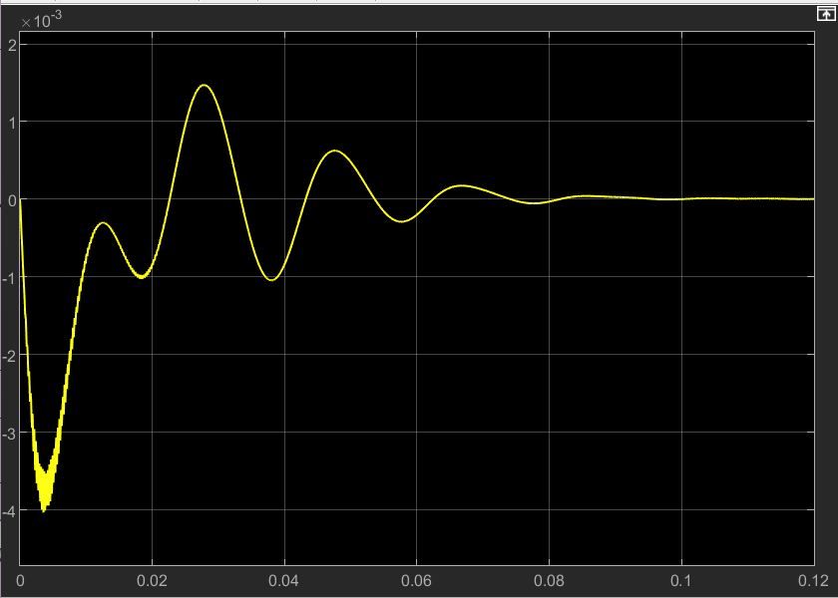




FLL Output Simulation single-phase to ground
$$V_{α}^{+}$$
$$V_{β}^{+}$$
$$V_{α}^{−}$$
$$V_{β}^{−}$$

Slide 29
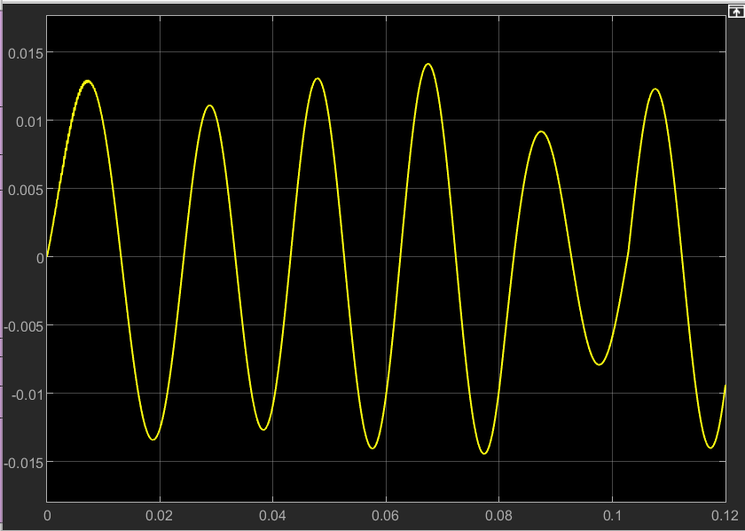
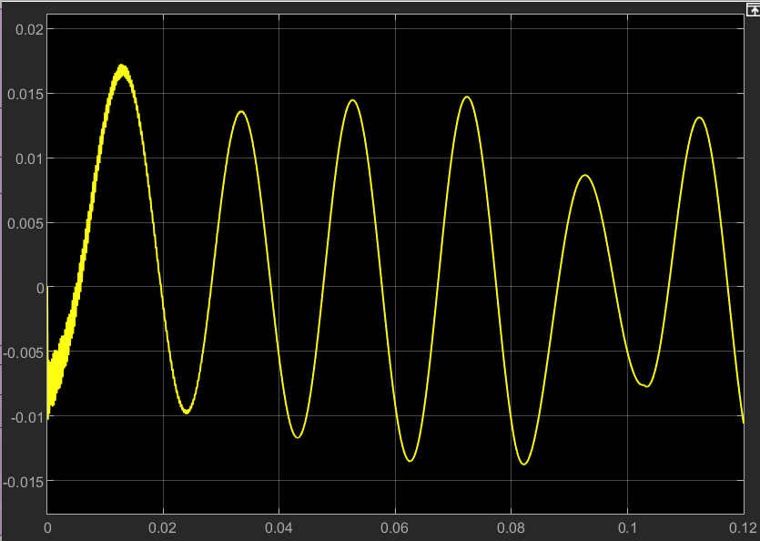
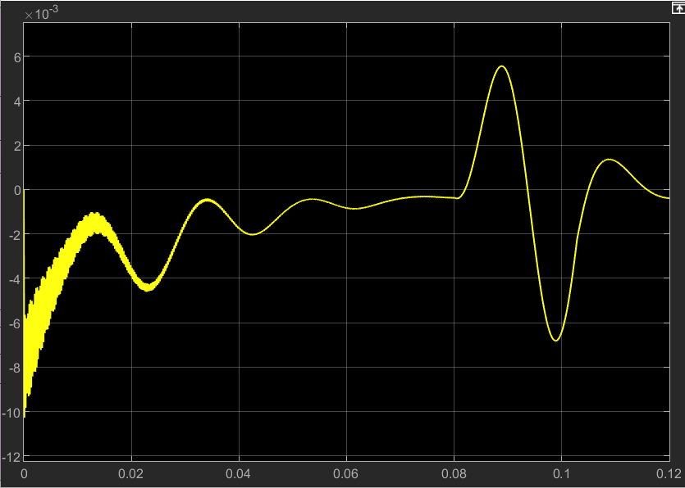
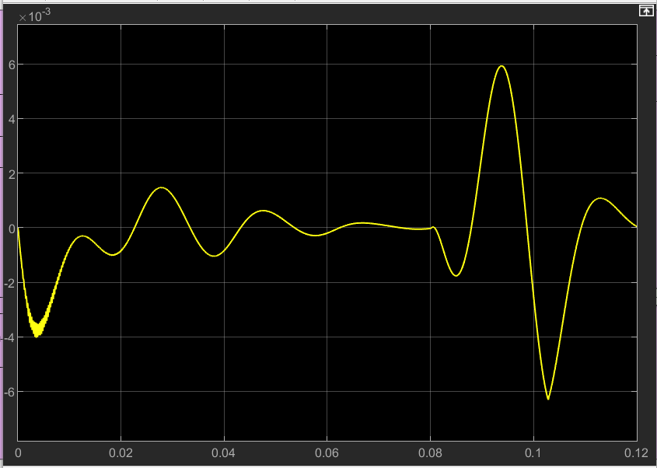
FLL Output Simulation two-phase short
$$V_{α}^{+}$$
$$V_{β}^{+}$$
$$V_{α}^{−}$$
$$V_{β}^{−}$$

Slide 30
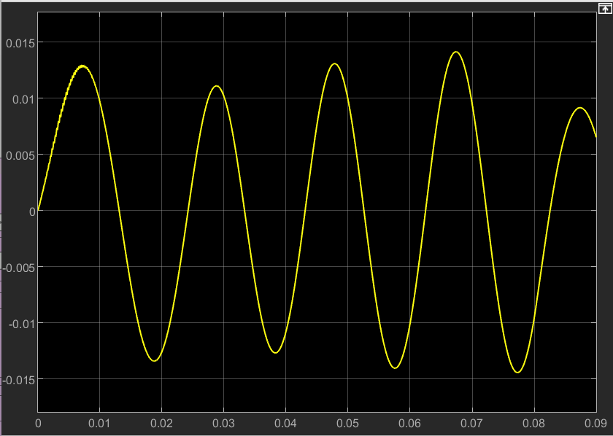
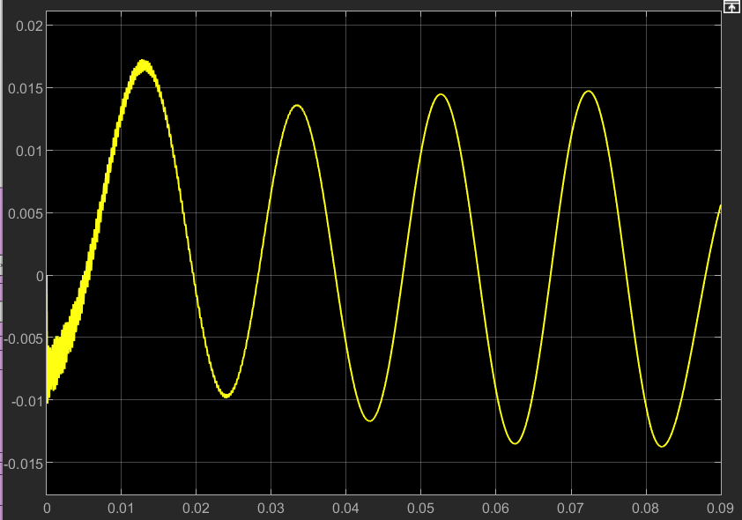
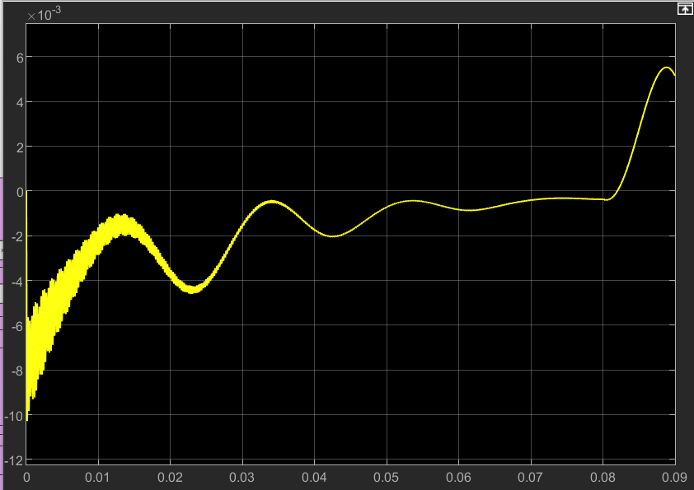
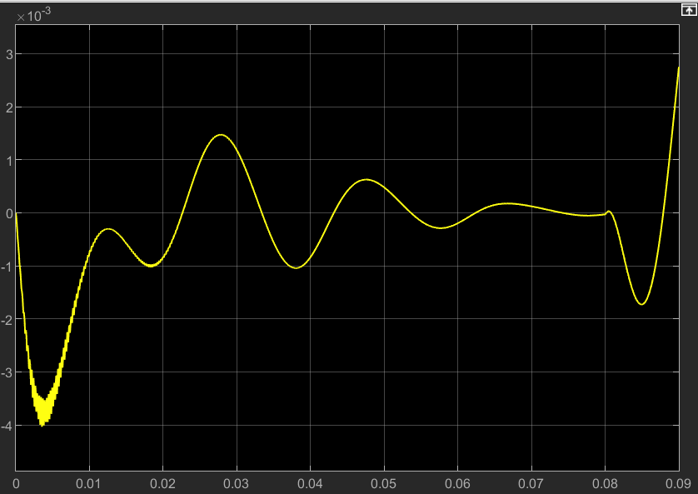

FLL Output Simulation two-phase to ground
$$V_{α}^{+}$$
$$V_{β}^{+}$$
$$V_{α}^{−}$$
$$V_{β}^{−}$$

Slide 31
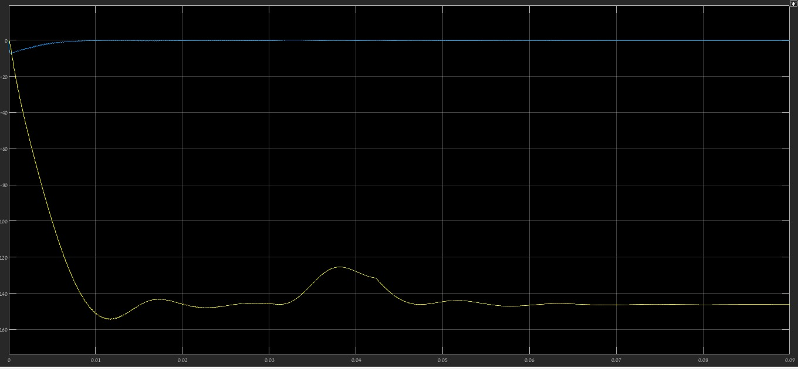
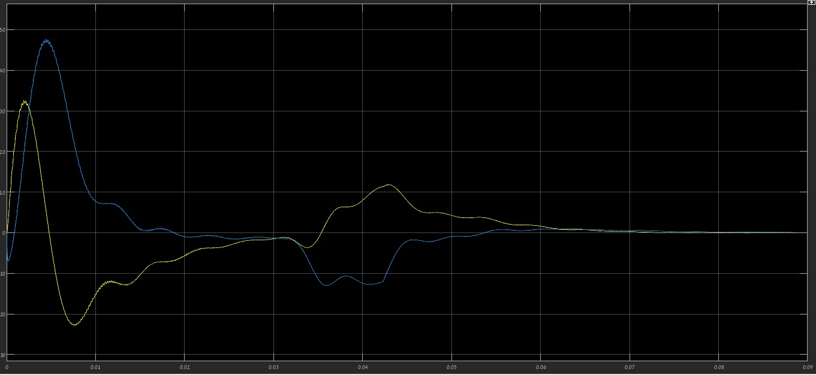






PLL Output Simulation single-phase to ground
$$V_{q}^{+}$$
$$V_{dq}^{+}$$
$$V_{d}^{+}$$
$$V_{q}^{−}$$
$$V_{dq}^{−}$$
$$V_{d}^{−}$$

Slide 32
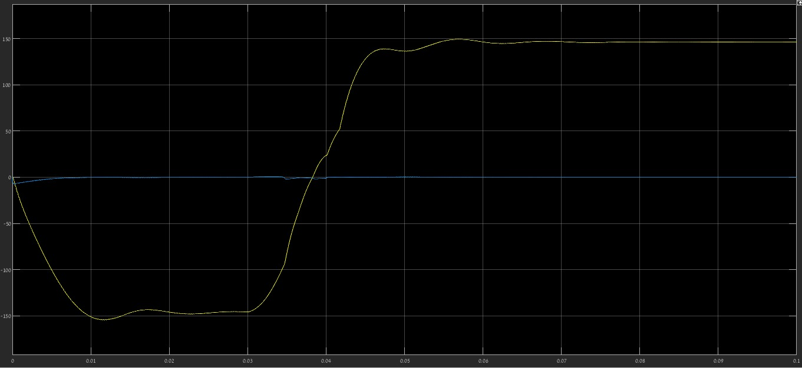
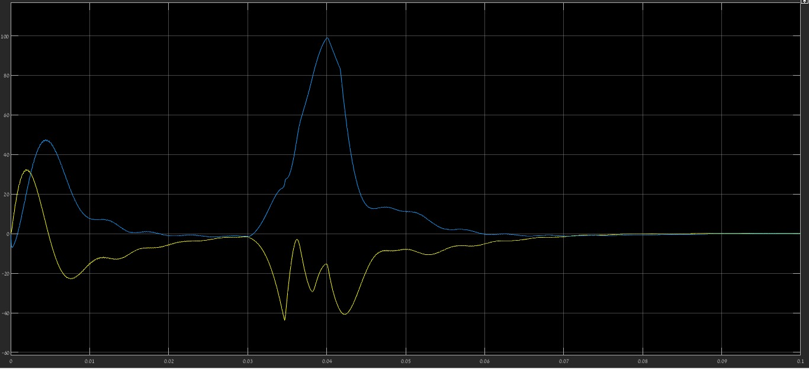




PLL Output Simulation two-phase short
$$V_{d}^{+}$$
$$V_{dq}^{+}$$
$$V_{q}^{+}$$
$$V_{q}^{−}$$
$$V_{dq}^{−}$$
$$V_{d}^{−}$$

Slide 33
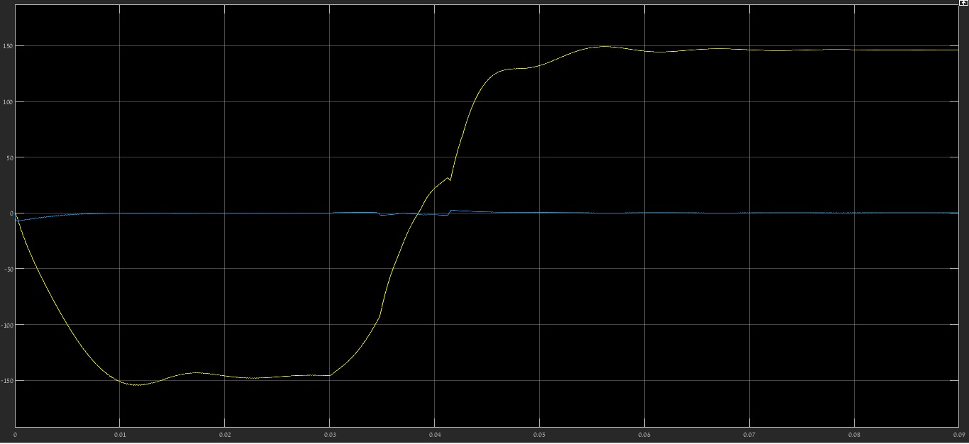
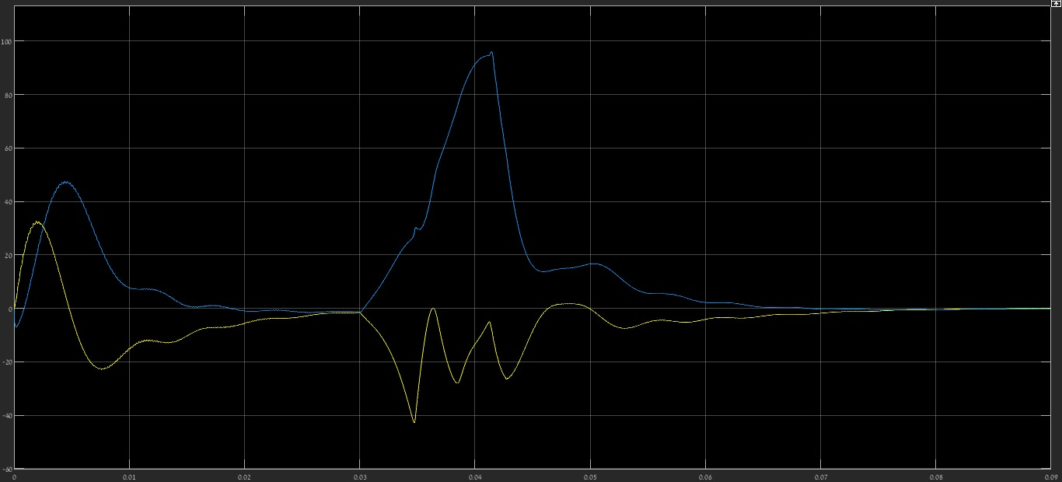




PLL Output Simulation two-phase to ground
$$V_{dq}^{+}$$
$$V_{q}^{+}$$
$$V_{d}^{+}$$
$$V_{q}^{−}$$
$$V_{dq}^{−}$$
$$V_{d}^{−}$$

